Slide 1

GCIS-124
Software Development & Problem Solving
07: Data Structures III

Slide 2
Data Structures III
In this unit we will continue exploring abstract data types and data structures.
An abstract data type describes the behavior of a data structure from the perspective of its user without providing any implementation details.
Every abstract data type (ADT) may be implemented in more than one way.
When solving a new problem, choosing the most efficient implementation is just as important as choosing the correct data structure.
We will examine two different abstract data types and implement each of them in at least one way including:
Tree Sets
Hash Sets
Tree Maps
Hash Maps
We will begin by focusing on the Set ADT.
Hashing data structures, like sets and maps (dictionary) are built on top of an array.
A hash function is used to convert arbitrary values into integers, which can then be used to find an index in the array.
"abc"
"def"
"ghi"
"jkl"
Hash Function
0 | 1 | 2 | 3 | 4 | 5 | 6 | 7

Slide 3
Review: Python Sets
A Set is an abstract data type that guarantees all of the elements it contains are unique.
We learned about them last semester in Python.
The interface for a Set commonly includes:
add - adds a value to the set
contains - determines if a value is in the set
remove - removes a value from the set
size - returns the length of the set
Take a moment and try to remember some of the problems we used set's to solve last semester.
Python's set uses a specific implantation that makes ordering impossible.
We'll make one of those too.
However, that's not a requirement for sets so we'll start with an implementation that is orderable.
Below is a quick review of how we used sets in Python.
1 a_set = {1, 2, 3}
2 a_set.add(4)
3
4 if 3 in a_set:
5 print("3 is in the set!")
6 else:
7 a_set.add(3)
8
9 a_set.add(2)
10
11 for value in a_set:
12 print(value)
13
14 b_set = set("abcdcba")
15 print(b_set) # {'c', 'd', 'b', 'a'}
Sets in Java will be used similarly but the notation (syntax) will be substantially different.
Notes:
Note that "in" is blue when used as an operator, and purple when used with a for loop.

Slide 4
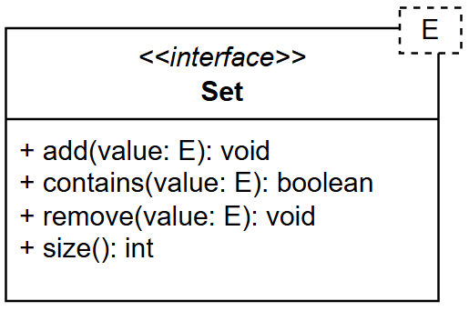
7.1
Set Interface
Before we create a specific implementation, we should define the ADT operations using an interface. This way, all implementations can be used interchangeably.
Start by creating a new sets package in this unit's repository which we'll use for all the set activities.
Using the UML on the left, create a Set interface.
Since we know we'll want to use it with lots of types, go ahead and make it generic from the start.
Ensure there are no errors by checking your problems tab.

Slide 5
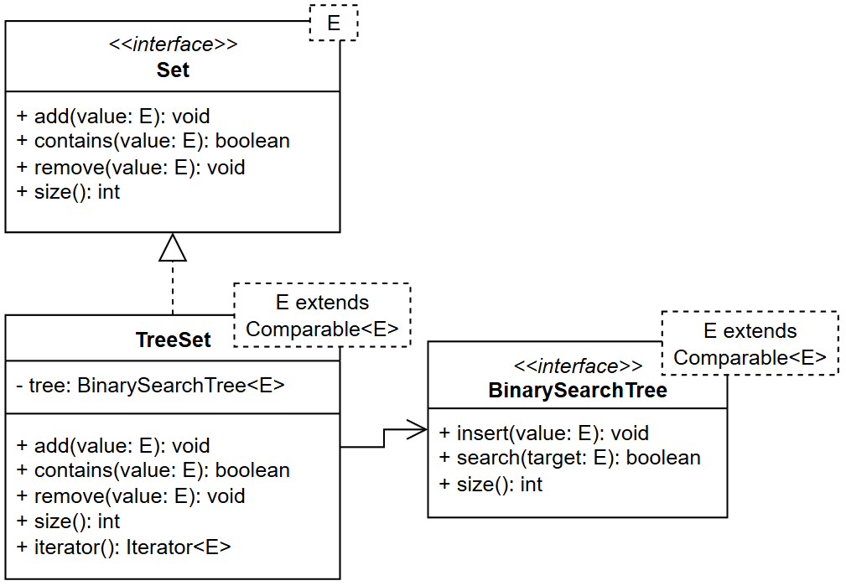
7.2
Tree Set
One common implementation for a Set is using a Binary Tree. It's relatively efficient and allows the items to be ordered. It's also convenient since we wrote a BinarySearchTree implementation last unit.
Start by creating a new class, TreeSet, that implements the Set interface.
Instead of an E the generic identifier for TreeSet should be
E extends Comparable<E>
Add a constructor that creates an empty BinarySearchTree for the tree attribute.
Implement the size method.
For now, stub out the other interface methods.
In main, create a Set and print its size.
Challenge: Add a toString implementation for the Set that returns the stored data as a String. Test it in main.
Don't worry about the scary looking E extends Comparable<E>. That just ensures E is comparable which is required for a BST.
Notes:
E extends Comparable<E>
Because BinarySearchTree uses compareTo method to place the values in correct order.
public class TreeSet<E extends Comparable<E>> implements Set<E>
public class TreeSet<Comparable<E>> implements Set<E> ➔ Incorrect Syntax. You can not use Interface name as part of generic definition.

Slide 6
7.3
Finishing Up
Let's finish up the TreeSet implementation by adding implementations for the add and contains methods.
Implement the add method using the BinarySearchTree's insert method.
Implement the contains method using the BinarySearchTree's search method.
Since our BinarySearchTree doesn't have a remove, our TreeSet's remove should throw the UnsupportedOperationException.
In main, test the TreeSet by adding a few items to it. Check that they were added by using the size or toString methods.
Also add tests for checking to see if the Set contains a value that that in the set and one that is not.
It's not uncommon for implementations of an interface to not support every operation. In this case, it won't support remove.

Slide 7
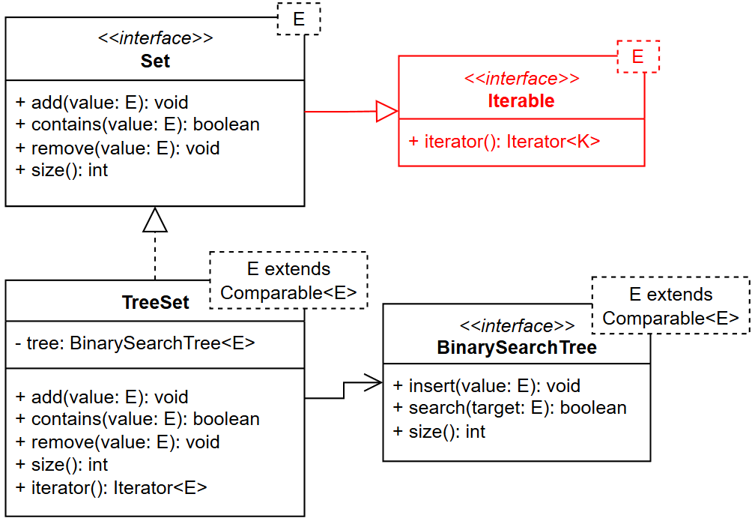
7.4
What About the for Loop?
At the moment, our TreeSet implementation does everything we mentioned the Python set does, except for one thing. We can't use it in a for loop. That's pretty useful so let's fix that now.
To use a data structure in a foreach loop, it must be iterable.
Using the updated UML on the left, make the Set and TreeSet iterable.
A NodeBST iterator has been provided for you.
Test your code by printing each element in your set, one per line, use a foreach loop.
Use the Iterable interface to enable Sets to be used in a foreach loop.
Notes:
Use Iterator Implementation here.

Slide 8
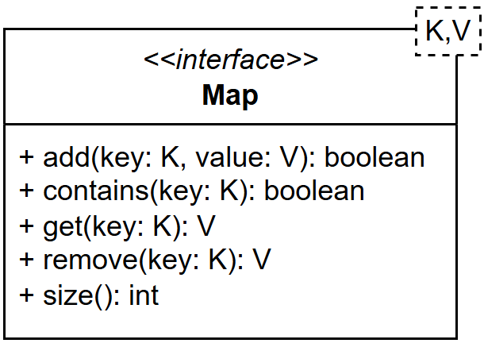
Maps
Java's name for an associative array is Map.
It is used to associate one object with another object.
Python's dictionary is one implementation of an associative array.
Normally, maps include at a minimum the following operations:
add(key, value) - adds the key, value pair to the map. If they key already exists it replaces the existing value of the key with the specified value
get(key) - returns the value associated with the key. Throws an exception if key is not in the map
contains(key) - determines if key is in the map
remove(key) - removes the key entry from the map
size() - the number of entries in the map
Our implementation will have all of these, and a couple of quality of life operations.
toString() - for easy viewing of the stored data
iterator() - allow iteration by keys (similar to python)
Maps are a common and powerful data structure that lets developers associate one object with another one.

Slide 9
Review: Python Dictionaries
A dictionary is sort of like a list, except instead of numeric indices, it uses keys.
As with a list index, a key can be used to retrieve a value from the dictionary.
In this way, a dictionary can be said to be a collection of key:value pairs.
Given some key, the dictionary will return the corresponding value.
This is similar to a list that, given some index will return the value at that index.
Keys do not need to be numbers. They can be many different Python types, including strings.
Like sets, the Python dictionary is a hashing data structure.
A hash function is used to convert the key into an integer, which is then used to find an index in an array.
Because of this, only hashable types can be used as keys.
An empty dictionary may be created using the built-in dict() function or a pair of empty curly braces (this is why we can't create an empty literal set).
1 a_dict = dict()
2 b_dict = {}
3
4 c_dict = {"one":1, "two":2}
5 c_dict["three"] = 3
6 c_dict["one"] = 1111
A literal dictionary can also be created by enclosing key:value pairs in curly braces.
Keys can be used like indices in an array or list to add or change values in the dictionary.
Notes:
Give an example of Student.
Key : Student ID
Value : Student Object containing name, address, etc.

Slide 10
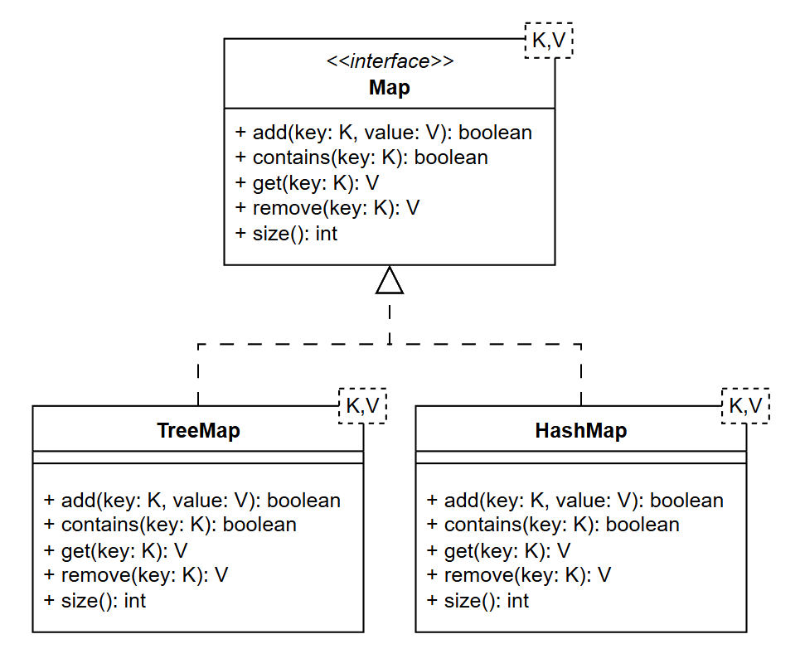
Implementations
Similar to the Set, a Map has a couple common implementations.
Tree based maps that maintain order by key
Hash based maps that are faster but have no order
A Tree based map implementation would be similar to the implementation we did for Set.
But with a key/value pair rather than a single value..
For this reason we'll only create a hash based map implementation.
At the end of the unit, we'll look at Java's implementations which includes a full tree and hash implementation.
Like many data structures, Maps have multiple common implementations.
Notes:
But with a key/value pair rather than a single value..
Use NodeBST<E> Where E is an object with attributes we need.

Slide 11
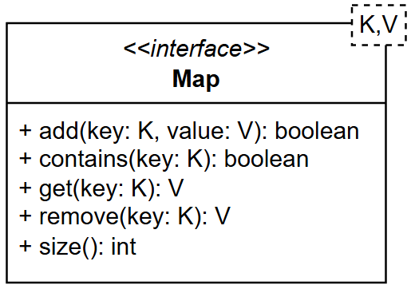
7.5
Map Interface
Before we create a specific implementation, we should define the ADT operations using an interface. This way, all implementations can be used interchangeably.
Start by creating a new maps package in this unit's repository which we'll use for all the set activities.
Using the UML on the left, create a Map interface.
Since we know we'll want to use it with lots of types, go ahead and make it generic from the start.
Ensure there are no errors by checking your problems tab.
The Map and Set interfaces are very similar, but there are subtle differences. Pay close attention when creating it.

Slide 12
Hash Map
Another common Map implantation uses hashing to store and retrieve the set items.
A hash function is a one-way function that, given an arbitrary input value, produces a number as output.
Converting input into a hash code is called hashing.
Most hashing data structures use an array to store the data.
Arrays are used because because all elements are created at construction and it's very efficient.
The hash function is used to convert the object being stored into an integer (hash code) which is used to get an index into the array.
Since there are over 2 billion possible "indexes" in a Java int, we don't want to make an array that big.
Instead, the hash code is constrained to the size of the array using modulo of the array length.
A hash map is a hashing data structure that is built on top of an array.
A hash function is used to convert arbitrary values into integers, which can then be used to find an index in the array.
"abc"
"def"
"ghi"
"jkl"
Hash Function
0 | 1 | 2 | 3 | 4 | 5 | 6 | 7
Notes:
Use the hashCode() function.
For number hashcode could be same as number.
How about String() → It could be different value.
Once you have the number then create the modulus to find exact location in the Array

Slide 13
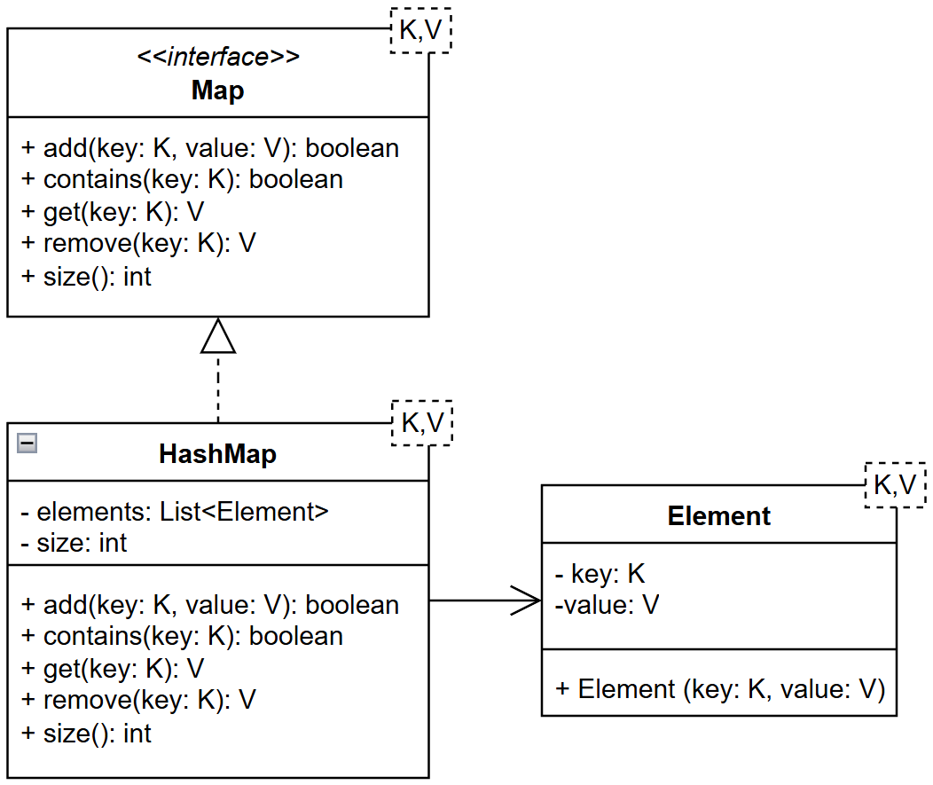
7.6
Implementing a Hash Map
Now that we've seen how hashing works with arrays, it's time to create our hash set implementation.
In the maps package, add a new class named HashMap.
Use the UML on the left to guide the class creation.
Since an array index can only store one item, create a small inner class that holds two items (the key and value) named Element.
We'll use a starting "array" capacity of 3, which you can hard code or add as a constant.
We're going to use an ArrayList for our "array".
In the constructor, create a new ArrayList and assign it to elements.
Then add capacity null entities to the list.
These are needed so we can access the indexes correctly.
The initial size will be 0 because it is a new map.
Implement the constructor and size and stub out the other methods.
While we previously discussed using an array to hold the elements, using an ArrayList will be simpler given Java's issues with generic arrays.
Notes:
We will use ArrayList<> for our purpose

Slide 14
Adding To a Map In Detail
key:
value:
"abc"
123
Value to be stored.
First, hash the key using a hash function.
Hash Function
This produces a hash code which is an integer.
96354
Modulo 8
Modulo the code by the size of the array to get the index.
2
"abc"
123
Array used for storage.
0 | 1 | 2 | 3 | 4 | 5 | 6 | 7
Store the kay and value at the index.

Slide 15
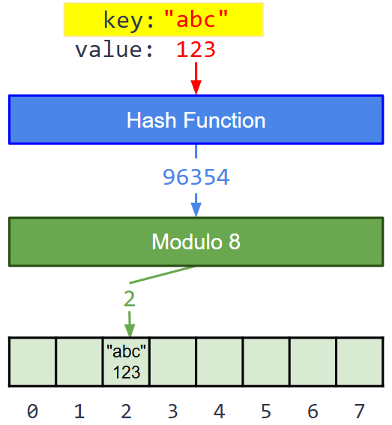
7.7
Add
The first order of business is to add something to our hash set. This will involve hashing the value and adding it to the underlying array.
Get the hash code by calling .hashCode() on the key of the key/value pair.
Using modulo arithmetic and Math.abs(), constrain the hash code to a value that will fit into the preallocated List.
Check the elements list at the determined index.
If it is not empty, check to see if the key at the stored index matches the provided key.
If they match, update the Element at index to store the new value.and return true.
If they don't match, return false.
Else, create a new Element using the key and value and set the element to the list at the index.
Increase the size by 1.
Return true.
In main, add a few items to the map, printing out the return value. How many did you need to add before you received a return of false?
We need to store the key and value as we have to check the key on each access.
Notes:
Why you’ll eventually get false
Because the capacity starts at 3, you only have 3 buckets. Once you try inserting a 4th different key that hashes to an already-occupied index, you’ll hit a collision and return false (per the slide’s simplified behavior).
Create Calculate Index Method first. Talk about how it may get negative.
Can a Object such as Student be used as key in Map
Yes ✅ — a Student object can absolutely be used as a key in a Map.
But there’s a very important rule.
If you use a custom object as a key in a HashMap, you MUST properly override:
equals()
hashCode()
Otherwise, your map will behave incorrectly.

Slide 16
7.8
Contains
One of the primary uses of a set is to check for containment. Let's add that feature now.
Calculate the index of the value using the same process as add.
If you didn't already, now might be a good time to create a separate private method for calculating an index rather than rewriting it for each method.
Check to see if the object being checked is equivalent to the one stored at that index.
Remember to use .equals and not ==
Return true if the are equal and false otherwise.
Test the contains method in main by looking for a value that is in the map and one that is not in the map.
Add and contains are very similar, except contains doesn't change the map.
Notes:
Implements ContainsKey method
Can null be stored as key
✔ YES — HashMap allows one null key.
Why only one?
Because a Map cannot have duplicate keys.
Internally:
null key is stored in bucket index 0
No hashCode() is called (since null has no methods)
You can also retrieve it:
❌ 3️⃣ TreeMap
Map<String, String> map = new TreeMap<>(); map.put(null, "Hello"); // ❌ NullPointerException
❌ NO — TreeMap does NOT allow null keys
Why?
TreeMap sorts keys using:
compareTo() or
Comparator
To compare, it must call a method on the key.

Slide 17
7.9
Get
Now that we have items in our map, it's time to add code to let us view the values when provided a key.
Use the contains method to see if the key is stored in the map.
If it is:
Calculate the index.
Check that the index element's key and the provided key match
Remember to use equals and not ==
If they do, return the index element's value. Do not return the entire element.
In all other cases, i.e. the keys don't match or there is not key, return null.
Test the method in main by getting a value that is in the map and one that is not in the map.
Since multiple keys can wind out having the same index, we always have to check the key equals the stored one.

Slide 18
7.10
Remove
While not used as often, sometimes it can be useful to remove items from a set. We'll implement that now.
Start by checking to see if the map contains the key.
If it does:
Check to make sure the stored key at index matches the key to be removed.
Use equals and not ==
If it the requested key:
Save the stored value as a temporary.
Set the Element at index to null
Decrement the size
Return the temporary value.
If it is not the requested value or the key isn't contained:
Return null
Test in main by removing an item in the set and verify it was removed. Then try removing an item that is not in the set.
Remove should return the value of the item that was remove, not the item itself.

Slide 19
Collisions
There are an infinite number of possible inputs to a hash function, but there are a finite number of possible outputs.
The range of hash code values is limited by the size of an integer in Java.
This means that it is not only possible, but likely that two different values will have the same hash code.
This is one reason why hash functions only work one-way.
The array used to store hashed values is also very small compared to the range of possible hash codes.
This is to conserve memory; we don't want to allocate an array big enough to hold billions of elements if we don't need to.
The hash code must be converted into an index in the array, e.g. using modulo with the size of the array.
Together, duplicate hash codes and a limited number of available indices in the array mean that it is inevitable that two values will be hashed to the same index.
When two different values are hashed into the same index in an array, this is referred to as a collision.
"abc"
"def"
"ghi"
"jkl"
Hash Function
0 | 1 | 2 | 3 | 4 | 5 | 6 | 7
When this happens, it is not acceptable to simply throw away one of the values.
The collision must be resolved in some way, and this has a negative impact on performance.

Slide 20
Hash Functions
A good hash function has the following characteristics.
It is fast meaning that it runs in constant time (or close to it relative to n).
It is consistent. Because the hash function is used to store and retrieve values it must always return the same hash code for the same input.
It minimizes collisions by ensuring that, as much as possible, two different input values will result in two different hash codes.
A bad hash function will break one or more of these rules, which will slow down the performance of a hashing data structure.
We would like the basic operations like adding new elements to a set or a dictionary to run in constant time.
A bad hash function can slow the data structure down to the point where it is no faster than using a list or an array.
There are two basic ways to resolve collisions in a hashing data structure: open addressing and chaining.
When a collision occurs while using open addressing, the data structure will search for the next open address in which to store the value.
When a collision occurs while using chaining, the elements are stored in a list at each index.
In both cases, adding or finding an element requires a linear search over some number of elements. The more often collisions occur, the more the time complexity approaches O(n) instead of O(1).
Notes:
You may mention that we will cover this in much more detail in the second course.
🔹 Types of Open Addressing
There are 3 common probing strategies:
1️⃣ Linear Probing
Move one step at a time: index = (hash + 1) % tableSize
2️⃣ Quadratic Probing
Move in squares: hash + 1²
3️⃣ Double Hashing
Use a second hash function to determine jump distance. Second hash % size
Get
🔹 Core Rule
In open addressing, get(key) must:
Follow the SAME probing sequence that was used during insertion.
Example
10 → hash = 3 → store at index 3 17 → hash = 3 → collision → store at 4 24 → hash = 3 → collision → store at 5
🔹 Now: get(24)
Step 1
Compute hash:
hash = 24 % 7 = 3
Check index 3:
table[3] = 10 ❌ not 24
index = (3 + 1) % 7 = 4
Check index 4:
table[4] = 17 ❌ not 24
Probe again:
index = 5
Check:
table[5] = 24 ✔ FOUND

Slide 21
Chaining in Detail
"a":1
"c":3
"e":5
Each element in the array is a list
[ ]
[ ]
[ ]
[ ]
[ ]
 | "a":1
 | "a":1 |  | "b":2
 | "c":3
[ ]
[ ]
 | "a":1 | "d":4 | "b":2
 | "c":3 | "e":5
[ ]
[ ]
[ ]
[ ]
New items are added to the list at the hashed index
[ ]
"b":2
"d":4
"f":6
When a collision occurs, append the item to the list at the hashed index.
[ ]
[ ]
[ ]
[ ]
 | "a":1 |  | "b":2
 | "a":1 | "d":4 | "b":2
 | "c":3
 | "a":1 | "d":4 | "b":2
 | "c":3 | "e":5
 | "f":6
[ ]
[ ]
[ ]
[ ]
[ ]
[ ]
[ ]
This eliminates clustering but an overfull map will still be inefficient.
[ ]
Notes:
Use the term bucket

Slide 22
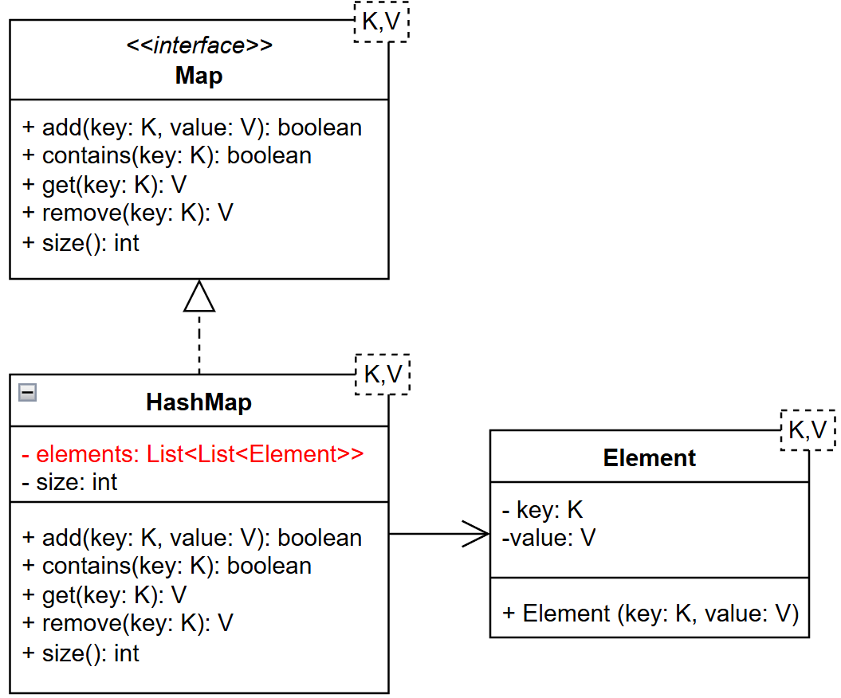
7.11
Chaining
Currently we can only get 1 or 2 items in our set before we have a collision and start losing data. We can fix that by changing the implementation to use chaining.
To start with adjust the the class to match the updated UML on the left.
The only real change is the type of the array
In the constructor, initialize each element of the Array with a new LinkedList<Element>.
Previously it was initialized with null.
Create an empty map and verify it has a size of 0.
You may need to temporarily comment out some of the existing code due to the array type change.
With chaining, each index is a list.
Notes:
Following changes will occur for Chainging
Definition of elements
Constructor

Slide 23
7.12
Next Link in the Chain
Now that we've adjusted elements to use chaining we need to adjust each of the implemented methods to properly use it. This involves hashing to a location in the array and then working with the inner list.
"f":6
add(key, value): Calculate the index and scan the list at index (use a foreach loop):
If the key is found, update the value and return true
Otherwise, append the new element to the list, increase size, return true.
contains(key): Calculate the index, if the requested key is in the inner list return true, otherwise return false
get(key): Calculate the index and scan the list:
If the key is found, return the associated value
Otherwise return null
remove(key): Calculate the index and scan the list:
If the key is found, remove the containing element, decrease size, and return the associated value
Otherwise return null
You may be tempted to use contains for get and remove but it doesn't really save you any typing and is less efficient than searching directly.
 | "a":1 | "d":4 | "b":2
 | "c":3 | "e":5
 | "f":6
[ ]
[ ]
[ ]
[ ]
When using chaining, collisions are added to the end of the array at index.
For most operations, you'll need to walk the list to find the element to change.

Slide 24
7.13
toString
Hopefully at this point you have a fully functional HashMap. While it works, it's currently impossibly to see what all the keys and values are using only the map. Let's fix that by adding a toString.
Write a toString for the class that returns the entries as a comma separated list surrounded by curly braces ({}).
Example: {"a":1, "c":3, "b":2}
First, Create a String array of length size to hold all the key-value pairs.
Visit every index in the the elements outer list and then every element in the inner list.
For each element in the inner list, add the key value pair to the string array.
Now might be a good time to write a toString method for the Element inner class.
Lastly, join the array together with ", " as the separator to create the string and add the beginning and ending curly braces.
String[] words =
{"Java", "is", "fun"};
String result =
String.join(" ", words);
System.out.println(result);
Java is fun
String.join is a convenient way to add a collection of items together as a string with a set delimiter.
It is more efficient than multiple +'s and handles the ending delimiter well.

Slide 25
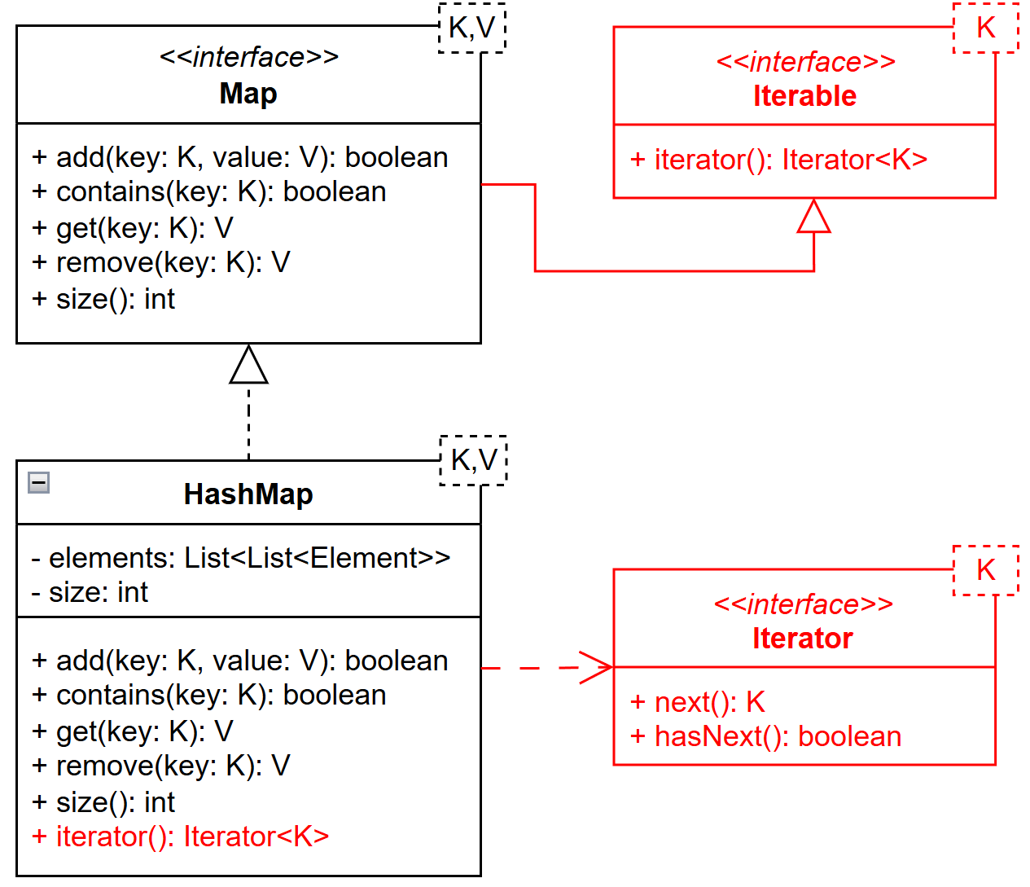
7.14
Iterator
While being able to see all the data is helpful, it doesn't let us programmatically use the data in the HashMap. For that, we need an iterator so we can view the keys in a foreach loop.
First, have the Map interface extend Iterable.
Only for the keys, similar to python
In HashMap, implement the iterator, method by returning an anonymous class that implements Iterator.
Most likely, you'll want an index for the outer array and an index for the inner array (i.e. outerIndex and innerIndex).
hasNext() should look through the outer array until it finds the next inner array that is not empty.
If innerIndex is valid, increment the innerIndex and return true.
If the innerIndex is out of range, increment the outerIndex, set the innerIndex to 0, and keep looking.
If the outerIndex is out of range, return false.
next() should return the key at the outer index | inner index location and increment the inner index.
Element class removed for readability.

Slide 26
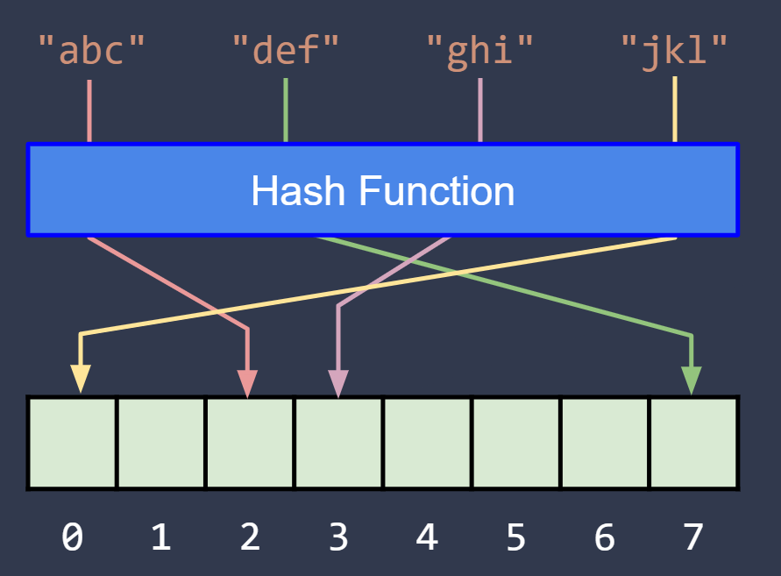
HashMap Complexities
An ArrayList offers constant time access provided that the index of the element is known.
anArray.get(5) = "abc"
a_string = anArray.get(7)
We use the hash function to find the index.
When using chaining, the inner LinkedList must be searched which is a O(n) operation.
Therefore the complexity of our HashMap will be determined by how large the linked lists are.
If every list has only one or two items in it, the map will have a time complexity of O(1) for each individual operation.
If the chains are long, the complexity will approach O(n), where n is the average inner list length.
For this reason, it's important we don't overfill the map.
I.E. We want the size of the map to be about the same as the length of the outer ArrayList.
This system also only works if our hash function evenly distributes the hash codes.
I.E. If everything hashes to index 0, the complexity will be O(n) since it's basically just a linked list at that point.
The primary characteristic of a set is that it can maintain a collection of unique elements with very good performance.
Adding a new element and finding an element using the in operator should both run in constant time.
But the nature of the set's hashing algorithm means that the order of the elements is arbitrary.

Slide 27
7.15
Resizing
Currently you should be able to add any number of items to your HashMap. However, with a capacity of 3 it won't take very long to lose its efficiency. Think of storing 1000 items in the set. Each list would be ~333 items long, each of which require a linear search. To solve this, let's grow the outer ArrayList if the size equals the list's capacity (elements.size()).
if need to resize:
oldElements = elements
newElements = new array list
add size * 2 inner linked lists
make unmodifiable
elements = newElements
size = 0
add() oldElements elements to the map
Create a new private method, resizeIfNeeded, to resize the list.
First, check to see if the map's size is >= elements.size().
If so create a new ArrayList and add size * 2 LinkedLists to it.
reference the constructor
Make the list unmodifiable to ensure new items cannot be added.
Collections.unmodifiableList(newArrayList) returns an unmodifiable view of the new ArrayList.
Set the size equal to 0
Store a reference to elements and change this.elements to reference the new unmodifiable list.
For each entry in the old elements list of lists, add the Element to the map using the this.add method.
Make sure to test that everything is working as expected.
To resize, create a new elements ArrayList that is twice as big as the original.
Swap in the new ArrayList and add all the elements from the old list to the new one.
Notes:
purpose of this line elements = Collections.unmodifiableList(newElements);
In your assignment slide, it says:
"Make the list unmodifiable to ensure new items cannot be added."
This means:
Prevent accidentally changing the number of buckets
Ensure resizing happens only through resizeIfNeeded()
Protect structural integrity of the hash table
So the purpose is:
Protect the outer bucket structure.

Slide 28
Sets & Dictionaries
Take a quick look at the review code on the right.
Python uses a hashing based implementation for both its set and dictionary.
For this reason their usage and constraints are very similar.
In fact, it is common to implement a hashset using a hashmap.
For the most part all of the operations will just be a pass through to the hashmap methods.
Example for the HashSet class:
@Override
public boolean contains(E value){
return map.contains (value)
}
There are a couple places where we'll need to make some small adjustments to the map logic.
add - Maps allow for overwriting the value but sets dont.
remove - Map returns the removed value but sets return a boolean.
toString - Maps have two pieces for each element while sets have one.
Sets and Dictionaries can be created/initialized using curly braces ({})
1 a_set = set ()
2 b_set = {1, 2, 3}
3
4 if 3 in a_set:
5 print ("3 is in the set!")
6 else:
7 a_set.add (3)
8
9 a_dict = dict ()
10 b_dict = {}
11
12 c_dict = {"one":1, "two":2}
13 c_dict["three"] = 3
14 c_dict["one"] = 1111
Keys can be used like indices in an array or list to add or change values in the dictionary.

Slide 29
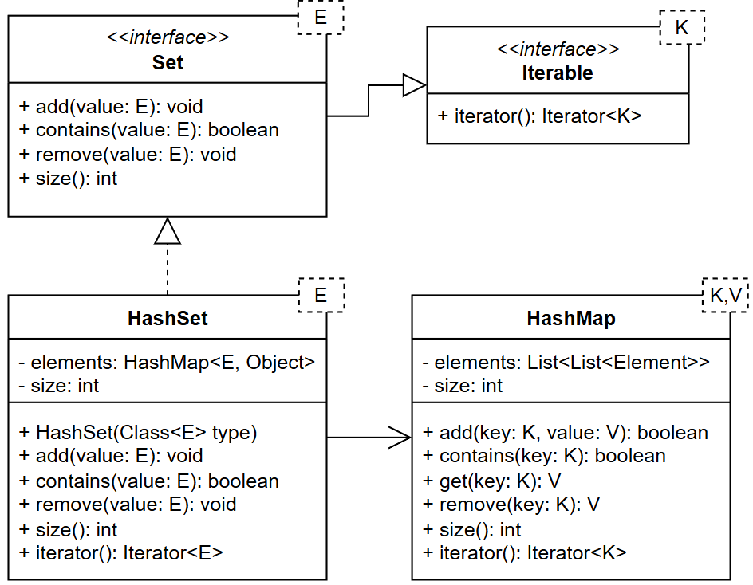
7.16
HashSet
Implement a HashSet using an internal HashMap. The set's values will be the keys in the map. The values in the map will always be null.
Create a new HashSet class in the sets package that implements the Set interface.
Implement all the required methods.
Most will just be wrappers for the map's methods except for:
add - Check to see if the value is a key in the map. If it is not, add the new value to the map as its key with a value of null. Otherwise, return false.
remove - Check to see if the value is a key in the map. If it is, remove the key from the map and return true, otherwise return false.
toString - This isn't required by the interface so you don't have to do it. If you want to, consider using the maps iterator.
A wrapper is a method that only calls a different classes method for its implementation.

Slide 30
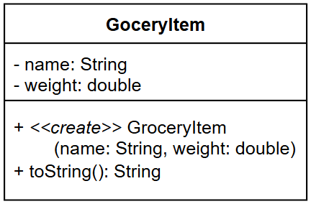
7.17
Test Time
Let's test our new HashSet by adding some custom class instances to it. We'll want to verify all the methods but we are really focusing on the uniqueness aspect.
Create a new class in the top level unit package named GroceryItem that uses the UML on the left.
Pick your favorite item that you regularly buy from the store that comes in multiple sizes (chips, drinks, gummies, etc.).
In main, create a HashSet of your GroceryItem.
Add at least 6 different instances of the same item to the set. I.E. 6 snack sized bags of Lay's potato chips:
set.add (new GroceryItem ("Lays Chips", 1));
Make sure you add 6 different instances, not just one instance 6 times.
What happens?
Fix the issue by creating an equals method for GroceryItem that makes all items with the same name equivalent.
Rerun your code, did it fix the issue fully?
Sets should ensure uniqueness among the items contained in it.
Notes:
Issue is that size will be 6
Before overriding equals/hashCode:
size will be 6 (all are “different objects”)
After overriding equals AND hashCode based on name:
size will be 1
only one “Lays Chips” stays in the set (first inserted)
{Diet Coke (16.9 oz), Diet Coke (16.9 oz), Diet Coke (16.9 oz), Diet Coke (16.9 oz), Diet Coke (16.9 oz), Diet Coke (16.9 oz)}
By default, Set will use equals() method to see if they are same of not. Objects are not equal.
==========
Just Implementing equals is not enough
Hash-based structures (like your HashSet built on HashMapChaining) use:
hashCode() first
Then equals()
If you override only equals():
The objects may be logically equal
But they still go into different buckets
So equals() is never even checked
We need to override hashcode as well.
if not, we might see multiple entries. Hash code is computed based on memory address.. Equal is called later
A HashSet works like this:
It uses hashCode() first to determine which bucket to place the object in.
Only if two objects land in the same bucket does it call equals() to check duplication.
Since you did NOT override hashCode(), Java uses the default implementation from Object:

Slide 31

Equal Hash Covenant
There is one last caveat to remember about hashing based data structures.
Hash is used to locate an item and equals is used to verify we have the correct item.
This means if two items that are equal don't hash to the same location bad things can happen.
For this reason, if the data structure used as the key has a custom equals method, it must also have a custom hashCode method that ensures equal items hash to the same location.
In practice, this normally means whatever values are used for equals are the values used in generating the hash code.
You can make a custom hash method by overriding the hashCode() method inherited from the Object base class.
Items that are equal must hash to the same location or errors can occur.

Slide 32
7.18
Create a Custom Hash
Even though we have an equals we don't have the equivalent hash so items are slipping through that shouldn't be. Solve this by adding a hash method that uses the same data as equals.
private String name;
private int SSN;
private double salary;
@Override
public boolean equals(Object obj) {
if (obj instanceof Slides other) {
return name.equals(other.name) &&
SSN == other.SSN;
}
return false;
}
@Override
public int hashCode() {
return name.hashCode() * SSN;
}
Add a hashCode method to the GroceryItem class.
The method should calculate a hash code using only the GroceryItem's name.
Re-run your code and verify everything is working correctly.
Now add a new GroceryItem to the set that has the same name but a different weight. I.E.
set.add (new GroceryItem ("Lays Chips", 14.5));
Run your code again and see what happens.
Update the GroceryItem's equals and hashCode to account for different weights. I.E. Two items with the same name but different weights are considered different items.
For Java objects, you can use their hashCode. For ints we normally just use the value directly.
Notes:
Problem is your are equallying only on name. so with different weight, they still based on name so just one entry.

Slide 33
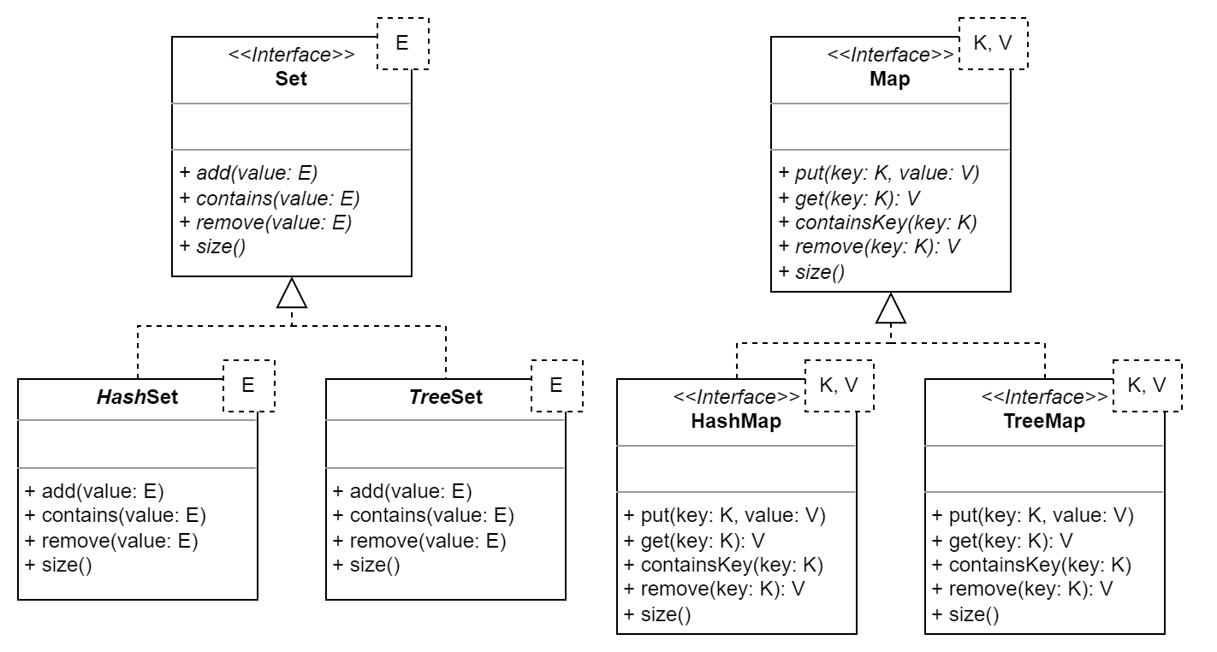
JCF Data Structures: TreeSet, HashSet, TreeMap, and HashMap
Just like us, Java has a Set and Map interface along with two implementations for each.
The TreeSet in Java is an implementation of the Set abstract data type that maintains its elements in sorted order.
The HashSet in Java is an implementation of the Set abstract data type that uses hashing, similar to pythons. It does not maintain order.
The TreeMap in Java is an implementation of the Map abstract data type that maintains its keys in sorted order.
The HashMap in Java is an implementation of the Map abstract data type that hashes on keys, similar to python's dictionary. It also does not maintain order.
Both tree-based data structures (TreeSet and TreeMap) require that the elements implement Comparable or that a Comparator is provided to help with the sorting.
The TreeSet and TreeMap are alternate implementations of abstract data types with which you are already familiar. They provide all of the same operations.
The fundamental difference is that both keep the values that they store in sorted order. This makes them perform slightly slower.

Slide 34
JCF Sets
You should recall that the primary characteristic of a set is that it guarantees that its elements are unique.
The set ADT provides at least the following operations:
add(E) - adds an element to the set.
remove(E) - removes an element from the set.
contains(E) - returns true if the element is in the set, and false otherwise.
size() - returns the number of elements in the set.
A hash set provides constant time (O(1)) performance for all basic operations.
The drawback is that the elements are stored in an unpredictable order.
Java's implementation is java.util.HashSet.
A tree set maintains its elements in sorted order.
This means that the elements must implement Comparable or a Comparator must be provided.
Elements are stored in a binary tree similar to a heap.
The expected time complexity of most basic operations is therefore O(log₂n).
Java's implementation is java.util.TreeSet.
Java provides two main set implementations: HashSet and TreeSet.
1 Set<String> strings = new TreeSet<>();
2 strings.add("z");
3 strings.add("y");
4 strings.add("x");
5
6 for(String s : strings) {
7 System.out.println(s);
8 }
A HashSet is faster, but it's elements are stored in arbitrary order. The TreeSet maintains its elements in sorted order at the cost of time complexity.

Slide 35
A Closer Look at the TreeSet
1 Set<String> strings = new TreeSet<>();
2 strings.add("z");
3 strings.add("y");
4 strings.add("x");
5
6 for(String s : strings) {
7 System.out.println(s);
8 }

Slide 36
A Closer Look at the TreeSet
TreeSet is an implementation of the same abstract data type as HashSet.
The type used with a TreeSet must be naturally Comparable…
1 Set<String> strings = new TreeSet<>();
2 strings.add("z");
3 strings.add("y");
4 strings.add("x");
5
6 for(String s : strings) {
7 System.out.println(s);
8 }
…or a Comparator can be passed into the constructor, e.g.:
A TreeSet provides all of the same operations as a HashSet, and also guarantees that the elements are unique…
new TreeSet<>(new DogComparator());
The major difference that you will notice is that, when iterating over the elements, they are in sorted order.
x
y
z

Slide 37
7.19
TreeSet Practice
There is nothing like conducting an experiment to see how the different JCF Set implementations work. Practice using a HashSet and a TreeSet to store strings and see how they behave differently.
Set<String> strings = new TreeSet<>();
strings.add("z");
strings.add("y");
strings.add("x");
for(String s : strings) {
System.out.println(s);
}
Create a new Java class named "SetsAndMaps" and define a method named "addAndPrint" that declares a parameter for a Set<String>.
Add at least 5 strings to the set in no particular order. Make sure to vary the case of the first letters of the strings, e.g. "aardvark", "Zoo", "Monkey", "zebra", "shark".
Use a for-each loop to iterate over the values in the set and print them to standard output.
Define a main method with the appropriate signature.
Call addAndPrint with an empty HashSet<String>.
Call it a second time with an empty TreeSet<String>.
Run your code.
We are using polymorphism to write code that will work with any kind of Set.
Notes:
1️⃣ HashSet Output
Order is unpredictable
Based on hash codes
No sorting
2️⃣ TreeSet Output
Sorted order
Natural ordering (String implements Comparable)
Uppercase letters come before lowercase

Slide 38
7.20
More TreeSet Practice
You may have noticed that the natural ordering of strings arranges capital letters before lowercase letters, e.g. "Zoo" comes before "aardvark". Let's fix that by writing a custom String Comparator and providing it to a TreeSet to use in sorting.
public class AlienComp
implements Comparator<Alien> {
@Override
public int compare(Alien o1, Alien o2) {
String sym1 = o1.getSymbol();
String sym2 = o2.getSymbol();
return
sym1.compareToIgnoreCase(sym2);
}
}
Create a new Java class named AlphabeticComparator that implements Comparator<String>.
Override the compare method to compare two strings.
Convert the strings to lowercase, then compare the first to the second, e.g. a.compareTo(b).
Return the result.
In the main method in the SetsAndMaps class:
Create an instance of the AlphabeticComparator and pass it into the constructor of a new TreeSet<String>.
Call the addAndPrint method with the new TreeSet.
Run your code!

Slide 39
Java Maps
(dictionary)
Java's equivalent to the Python dictionary is the map.
The map ADT provides at least the following operations:
put(K,V) - adds the specified key/value pair to the map.
get(K) - returns the value associated with the key.
remove(K) - removes the specified key and its value from the map and returns the value.
containsKey(K) - returns true if the key is in the map, and false otherwise.
size() - returns the number of key/value pairs in the map.
A hash map provides constant time (O(1)) performance for all basic operations.
The drawback is that the keys are stored in an unpredictable order.
Java's implementation is java.util.HashMap.
A tree map maintains its keys in sorted order.
This means that the keys must implement Comparable or a Comparator must be provided.
Like TreeSet, the expected complexity of all basic operations is O(log₂n).
Java's implementation is java.util.TreeMap.
Java provides two main map implementations: HashMap and TreeMap.
Map<Dog, Breed> dogs = new TreeMap<>(new DogComparator());
dogs.put(new Dog("Buttercup", 10), Breed.BASSET);
dogs.put(new Dog("Flash", 8), Breed.BLOODHOUND);
dogs.put(new Dog("Hermione", 2), Breed.BASSET);
dogs.put(new Dog("Princess Fluffypants", 1), Breed.CORGIE);
for(Dog dog : dogs.keySet()) {
System.out.println(dog + " is a " + dogs.get(dog));
}
A HashMap is faster, but it's keys are stored in arbitrary order. The TreeMap maintains its keys in sorted order at the cost of time complexity.

Slide 40
A Closer Look at the TreeMap
Map<Dog, Breed> dogs = new TreeMap<>(new DogAgeComparator());
dogs.put(new Dog("Buttercup", 10), Breed.BASSET);
dogs.put(new Dog("Flash", 8), Breed.BLOODHOUND);
dogs.put(new Dog("Hermione", 2), Breed.BASSET);
dogs.put(new Dog("Princess Fluffypants", 1), Breed.CORGIE);
for(Dog dog : dogs.keySet()) {
System.out.println(dog + " is a " + dogs.get(dog));
}

Slide 41
A Closer Look at the TreeMap
TreeMap is an implementation of the same abstract data type as HashMap.
The key type used must be naturally Comparable or a Comparator must be given to the TreeMap to use when sorting the keys.
Map<Dog, Breed> dogs = new TreeMap<>(new DogAgeComparator());
dogs.put(new Dog("Buttercup", 10), Breed.BASSET);
dogs.put(new Dog("Flash", 8), Breed.BLOODHOUND);
dogs.put(new Dog("Hermione", 2), Breed.BASSET);
dogs.put(new Dog("Princess Fluffypants", 1), Breed.CORGIE);
for(Dog dog : dogs.keySet()) {
System.out.println(dog + " is a " + dogs.get(dog));
}
A TreeMap provides all of the same operations as a HashMap, and also guarantees that the keys are unique…
It does not matter whether or not the values in the map are Comparable. Only the keys are sorted.
The major difference that you will notice is that, when iterating over the keys, they are in sorted order.
Princess Fluffypants(age 1) is a CORGIE
Hermione(age 2) is a BASSET
Flash(age 8) is a BLOODHOUND
Buttercup(age 10) is a BASSET
Notes:
TreeMap does not allow null values.

Slide 42
7.21
TreeMap Practice
There is nothing like conducting an experiment to see how the different Map implementations work. Practice using a HashMap and a TreeMap to store string keys and see how they behave differently.
Map<Dog, Breed> dogs =
new TreeMap<>(new DogComparator());
dogs.put(new Dog("Buttercup", 10), Breed.BASSET);
dogs.put(new Dog("Flash", 8), Breed.BLOODHOUND);
dogs.put(new Dog("Hermione", 2), Breed.BASSET);
dogs.put(new Dog("Princess Fluffypants", 1),
Breed.CORGIE);
for(Dog dog : dogs.keySet()) {
System.out.println(dog + " is a " +
dogs.get(dog));
}
Open the SetsAndMaps class and define a method named "putAndPrint" that declares a parameter for a Map<String, Integer>.
Add at least 5 key/value pairs to the map in no particular order. Make sure to vary the case of the first letters of the keys, e.g. "aardvark", "Zoo", "Monkey", "zebra", "shark".
Use a for-each loop to iterate over the keys in the map and print them to standard output.
Define a main method with the appropriate signature.
Call putAndPrint with an empty HashMap<String>.
Call it a second time with an empty TreeMap<String>.
Call it a third time with an empty TreeMap<String> that uses an AlphabeticComparator.
Run your code.
We are using polymorphism to write code that will work with any kind of Map.

Slide 43

Tree vs. Hash
A Red-Black Tree is a self-balancing binary search tree.
"Self-balancing" means that, as values are added, the tree makes sure that they are moved around to maintain balance without breaking the rules of a BST.
Remember that a balanced BST guarantees O(log₂n) search time.
The complexity of inserting into or removing from a red-black tree is O(log₂n).
Java's TreeSet and TreeMap both use red-black trees to keep elements in sorted order.
This means that inserting a new value or removing a value has a complexity of O(log₂n).
It also means that determining whether or not a value is contained in the data structure has a complexity of O(log₂n).
Recall that HashSet and HashMap provide O(1) (constant time) performance for all basic operations.
This means that adding, removing, and searching all run much faster than in the tree-based versions.
Therefore, you should only use a TreeSet or TreeMap if you must maintain the elements in sorted order.
Otherwise, you should choose the faster versions.
Not only are TreeSet and TreeMap harder to use because of the additional requirements that elements be Comparable and/or a Comparator be provided…
…but they are also slower than their hashing counterparts.
Unless the elements absolutely, positively must be kept in sorted order, choose the hashing version for its speed.

Slide 44
An Incomplete JCF Class Hierarchy
Iterable
Queue
Deque
ArrayDeque
PriorityQueue
(aka Heap)
Collection
LinkedList
Map
+add(E)
+contains(E):boolean
+remove(E)
+size():int
+put(key, value)
+get(key): value
+contains(K):boolean
+size():int
ArrayList
List
Stack
Legend
HashMap
TreeMap
Interface (italics)
Set
HashSet
Implementation
OK to use (green)
SortedSet
NavigableSet
TreeSet
Notes:
The data structures we have covered and that are available to use are in green. Don't spend too much time here explaining the various interfaces that we haven't discussed.

Slide 45
 | Java Sets Set<Integer> nums = new TreeSet<>(); Set<Integer> otherNums = new HashSet<>(); nums.add(1); | Java Maps (dictionary) // Can also use HashMap Map<Integer, String> numbers = new TreeMap<>(); numbers.put(1, “One”); numbers.put(2, “Two”); for (int i : numbers.keySet()) { System.out.println(numbers.get(i)); }
Unit 7 : Data Structures III

Slide 46


Summary & Reflection
What is one thing that you wish you knew more about as we move forward?
Binary Trees!
value
left subtree
right subtree
Binary Search Trees!
Comparable
Natural Order
Comparator
Alternate Order
Heaps
HashSet & TreeSet
HashMap & TreeMap
What is one new thing that you learned today?
What one question do you have about today’s class?
Please answer the questions above in your notes for today.

